Slide 1
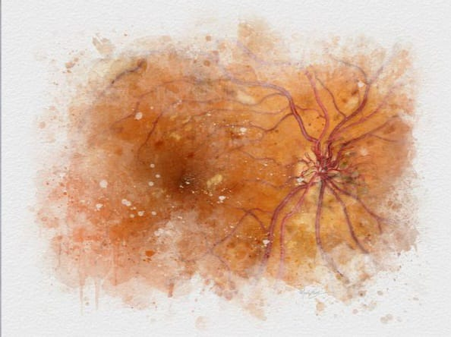

Slide 2
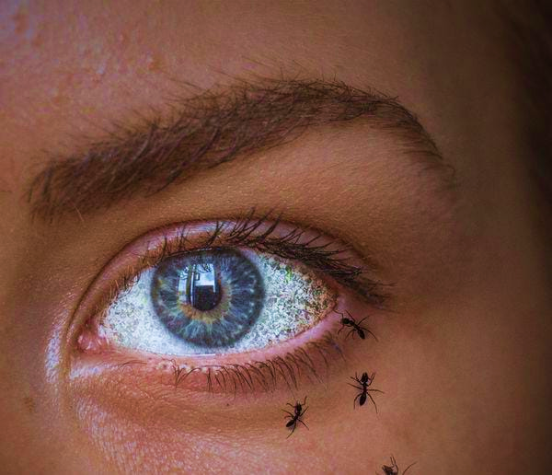
DIABEYE: COMPREHENSIVE DEEP LEARNING FRAMEWORK FOR DIABETIC RETINOPATHY CLASSIFICATION
TEAM NO. 33
TEAM MEMBERS -
VAIBHAVI SHENOY B
SHRAVYA K
SANKETHA S HEGDE
KAVANA H K

Slide 3
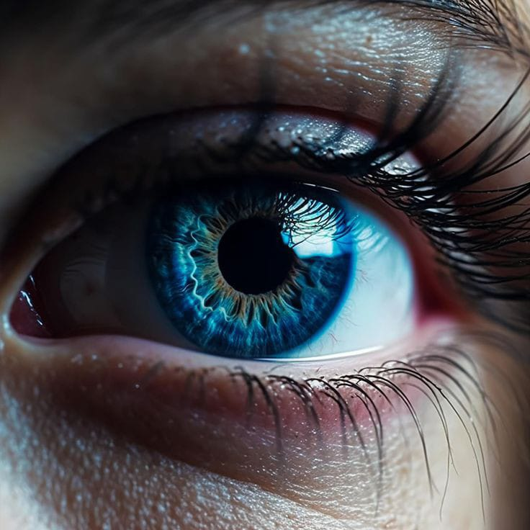
OUTLINE
INTRODUCTION
CURRENT DIAGNOSIS
PROBLEM STATEMENT
LITERATURE SURVEY
OBJECTIVES
METHODOLOGY
RESULTS

Slide 4
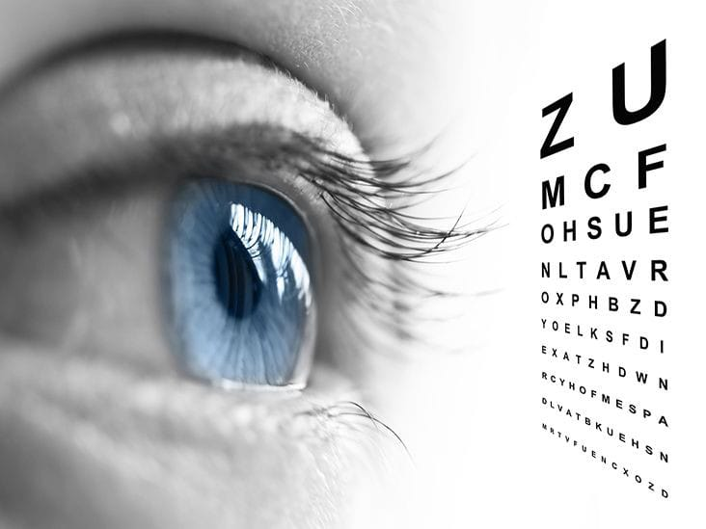
INTRODUCTION
People with diabetes can have an eye disease called diabetic retinopathy
Diabetic retinopathy is a diabetes complication that affects eyes. It's caused by damage to the blood vessels of the light-sensitive tissue at the back of the eye (retina)
The condition can develop in anyone who has type 1 or type 2 diabetes

Slide 5
STAGES OF DIABETIC RETINOPATHY
No Diabetic Retinopathy refers to the absence of any signs or symptoms of diabetic retinopathy in an individual with diabetes
Mild DR refers to the early stage of Diabetic Retinopathy (DR), a condition that can affect people with diabetes
Moderate DR refers to a more advanced stage of Diabetic Retinopathy, where there are more noticeable changes in the retina’s blood vessels.
Severe DR is an advanced stage of Diabetic Retinopathy where a significant portion of the retinal blood vessels are blocked.
Proliferative DR is the most advanced and vision-threatening stage of Diabetic Retinopathy

Slide 6
Current diagnosis process
DOCTOR’S APPOINTMENT
PERSUE
TREATMENT
EYES SCANNED
EYES
EVALUATED
SCHEDULE FOLLOW UP
APPOINTMENT
REVIEW RESULT
7-14 DAYS

Slide 7
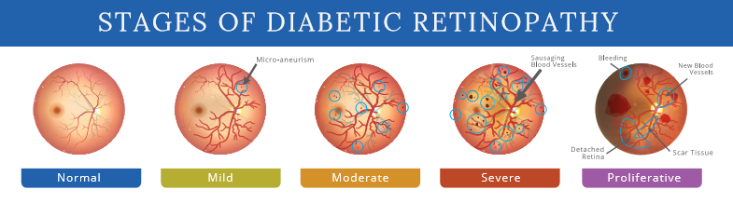
PROBLEM STATEMENT
Due to the challenges of manual diagnosis, we need an automated system to accurately classify diabetic retinopathy stages from retinal fundus images
This system will enhance screening efficiency, enable early identification of high-risk patients, and assist doctors in diagnosis and treatment

Slide 8
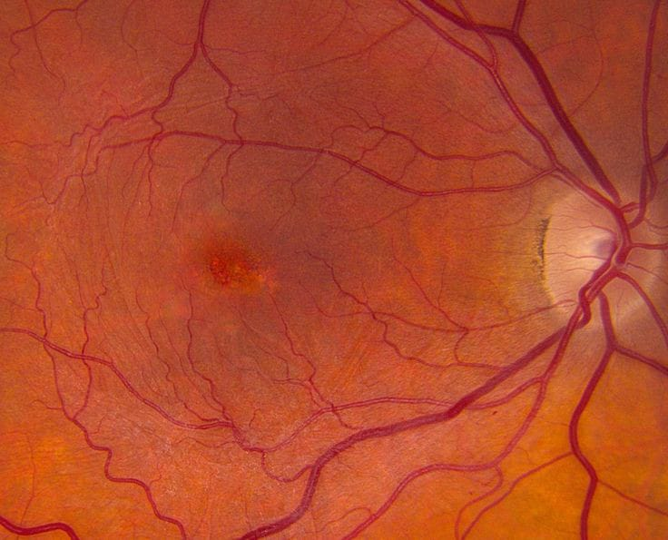
LITERATURE REVIEW

Slide 9
A Deep Learning Approach for Diabetic Retinopathy detection using Transfer Learning
Satwik Ramchandre, Bhargav Patil, Shardul Pharande, Karan Javali, Himangi Pande (2020 IEEE)
AIM
To efficiently classify the retina images of Diabetic and Healthy patients by preventing multiple reviews from medical professionals.
DATASET
Asia Pacific Tele Ophthalmology Society (APTOS) Symposium under a variety of imaging conditions.
METHODOLOGY
Feature based Transfer Learning , model pretrained on ImageNet Dataset.
RESULT
Accuracy for SEResNeXt32x4d was 85.15% and that for EfficientNetb3 was 91.44%.

Slide 10
Diabetic Retinopathy Detection using Deep Learning
Supriya Mishra, Seema Hanchate, Zia Saquib (2020 IEEE)
AIM
To simplify the classification of Diabetic Retinopathy, a time consuming task, using a vision based approach.
DATASET
“Aravind Eye Hospital” with class 0 - 1085 images, class 1 – 370 images, class 2 – 999 images, class 3 – 193 images, class 4 – 295 images.
METHODOLOGY
DenseNet 121Architecture with ImageNet for better accuracy, VGG16 Architecture.
RESULT
Accuracy for DenseNet was 73.26% and that for VGG16 was 96.11%.

Slide 11
Diabetic Retinopathy Grading Using ResNet Convolutional Neural Network
Muhammad Samer Sallam , Ani Liza Asnawi , Rashidah Funke Olanrewaju (2020 IEEE)
AIM
The goal of this research is to develop an accurate DR grading system, enhancing DR stage identification in patients.
DATASET
Kaggle
METHODOLOGY
ImageNet CNN model.
RESULT
The model achieved accuracy of 69.4%

Slide 12
Automated Diabetic Retinopathy Detection and classification using ImageNet Convolution Neural Network using Fundus Images
Jayakumari.C, Vidhya Lavanya, Sumesh E P (2020 IEEE)
AIM
To develop an automated system to detect and classify diabetic retinopathy by using ImageNet model to achieve higher accuracy.
DATASET
Kaggle
METHODOLOGY
ImageNet CNN model.
RESULT
Training model accuracy : 98.6%.

Slide 13
OBJECTIVES
To classify the stages of diabetic retinopathy from real-time fundus images
To apply preprocessing and augmentation techniques
To improve patient outcomes by facilitating early detection and intervention of diabetic retinopathy, preventing vision loss and reducing the burden of the disease.
To explore the potential of multitask learning

Slide 14
METHODOLOGY
Step 1: Dataset Preparation [Dataset Splitting]
Step 2: Data Preprocessing and Augmentation [ Image Dimensions, Data Augmentation ]
Step 3: Model Definition and Customization [Load Base Model , Add Custom Classification Layers ]
Step 4: Model Training [ Train the Model , Save the Model ]

Slide 15
METHODOLOGY
Step 5: Evaluation and Metrics [ Evaluate the Model on the Test Set]
Step 6: Predictions on New Data [Single Image Prediction ]
Step 7: Integrate with Frontend [Model Serving]

Slide 16
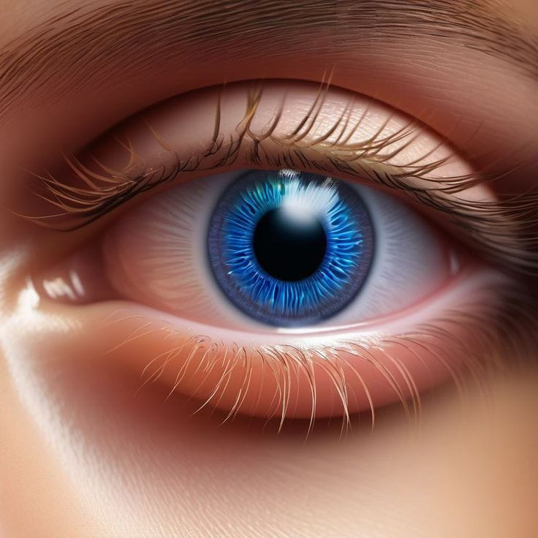
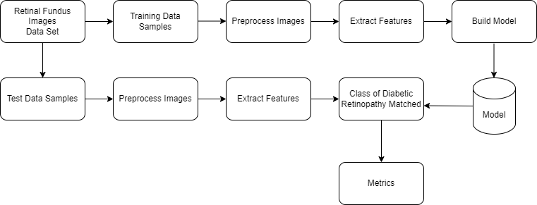
FLOWCHART

Slide 17
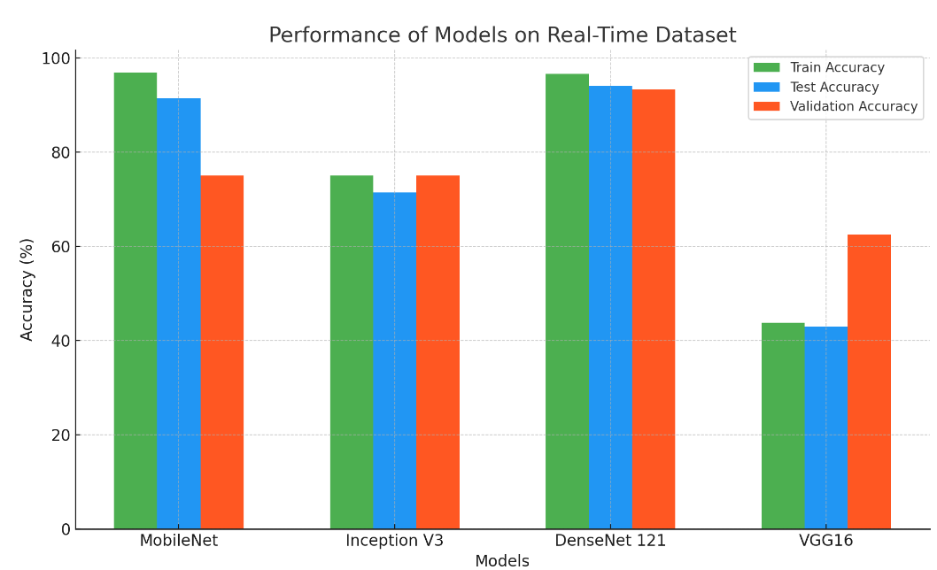
RESULTS
REAL TIME DATASET -
MODEL | TRAINING ACCURACY | TESTING ACCURACY | VALIDATION ACCURACY
MOBILE NET | 96.88% | 91.40% | 75.00%
INCEPTION V3 | 75.00% | 71.40% | 75.00%
DENSE NET | 96.60% | 94.00% | 93.35%
VGG16 | 43.75% | 43.00% | 62.50%

Slide 18
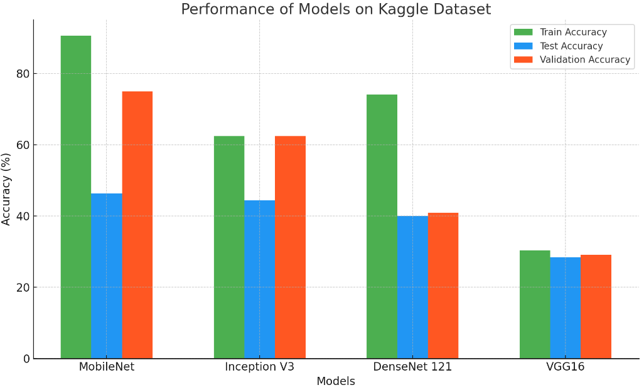
KAGGLE DATASET -
MODEL | TRAINING ACCURACY | TESTING ACCURACY | VALIDATION ACCURACY
MOBILE NET | 90.62% | 46.40% | 75.00%
INCEPTION V3 | 62.50% | 44.40% | 62.50%
DENSE NET | 74.13% | 40.00% | 40.93%
VGG16 | 30.36% | 28.40% | 29.13%

Slide 19
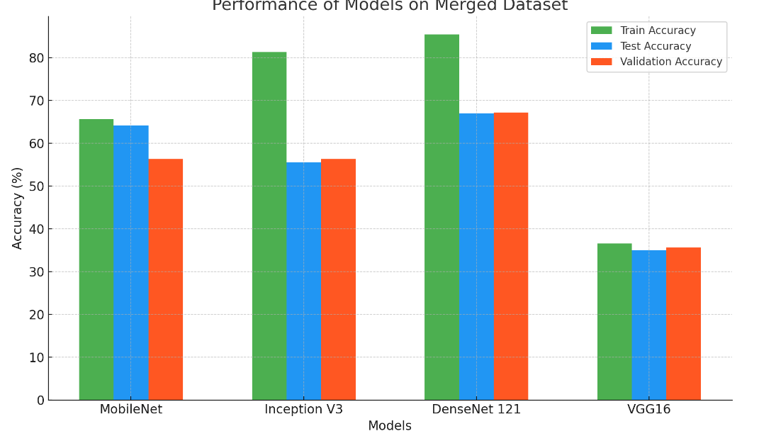
MERGED DATASET (REAL TIME + KAGGLE)
MODEL | TRAINING ACCURACY | TESTING ACCURACY | VALIDATION ACCURACY
MOBILE NET | 65.62% | 64.10% | 56.25%
INCEPTION V3 | 81.25% | 55.50% | 56.25%
DENSE NET | 85.37% | 67.00% | 67.14%
VGG16 | 36.58% | 35.00% | 35.58%

Slide 20
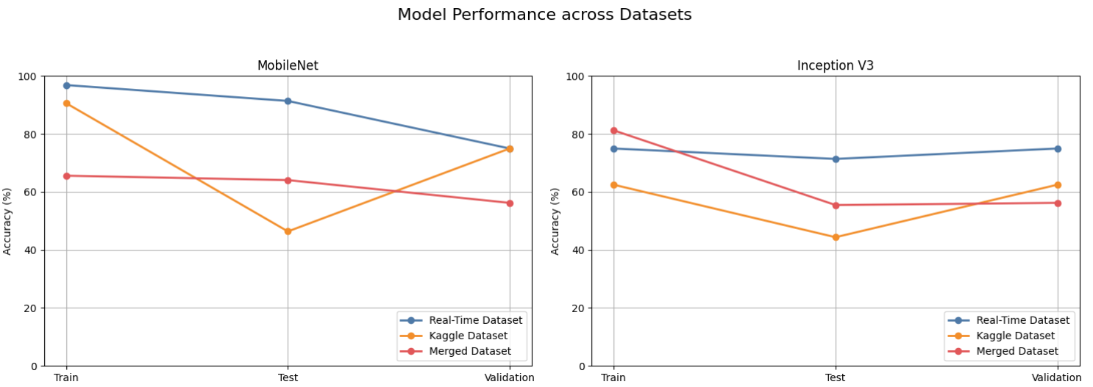
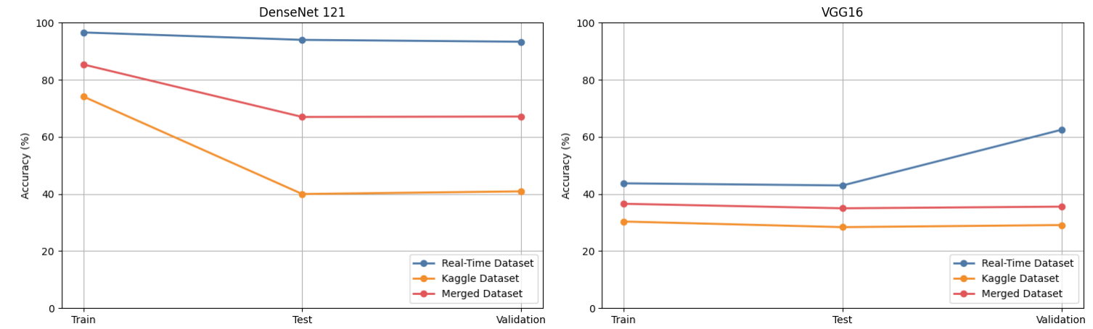

Slide 21
FUTURE SCOPES
Incorporating Larger and Diverse Datasets
Multimodal Data Integration
Real-time Screening and Mobile Solutions
Collaboration with AI and Medical Research
Regulatory Approvals and Clinical Trials
AI-assisted Personalized Treatment Plans

